Slide 1
Fashion segmentation
Segmentation of fashion-related items

Slide 2
Agenda
Project overview
Segmentation Architectures
- Structure
- Pros and Cons
- Train process and time
- Results/Examples
Alternative Applications
Conclusions
Guidelines:
20 min + 5-10 mins for questions
Clear explanation of method or algorithm
Illustrative results
Text size 16+; large enough to read

Slide 3
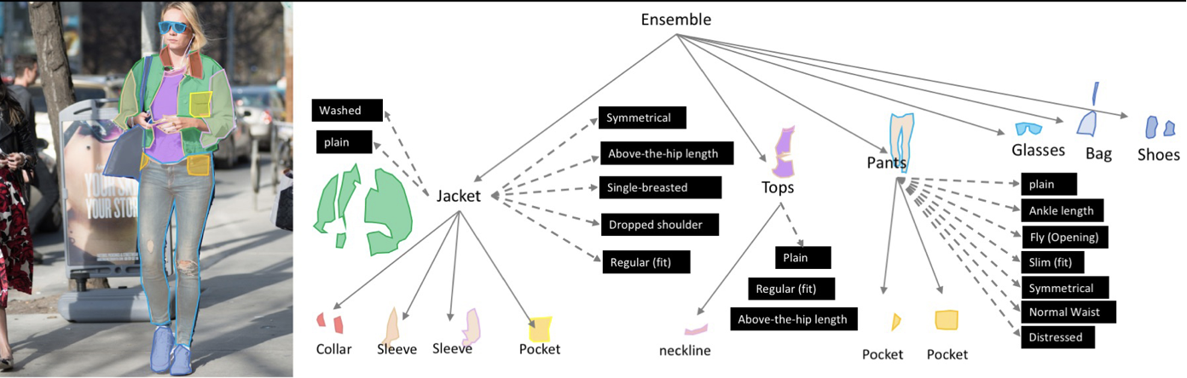
2019 Fashion Kaggle Competition
Objective: Segment clothing items and identify details and characteristics.
https://www.kaggle.com/c/imaterialist-fashion-2019-FGVC6/overview

Slide 4
Dataset
50k images
46 classes of fashion items
Image catalog containing image reference data and segmentation data
Pre-Processing
FashionDataset class
created to standardize commonly needed functions
Single instance holds relevant methods and data for dataset
Requirements
Classification and Segmentation
Handle images of varying sizes
Dataset is large enough to use without augmentation

Slide 5
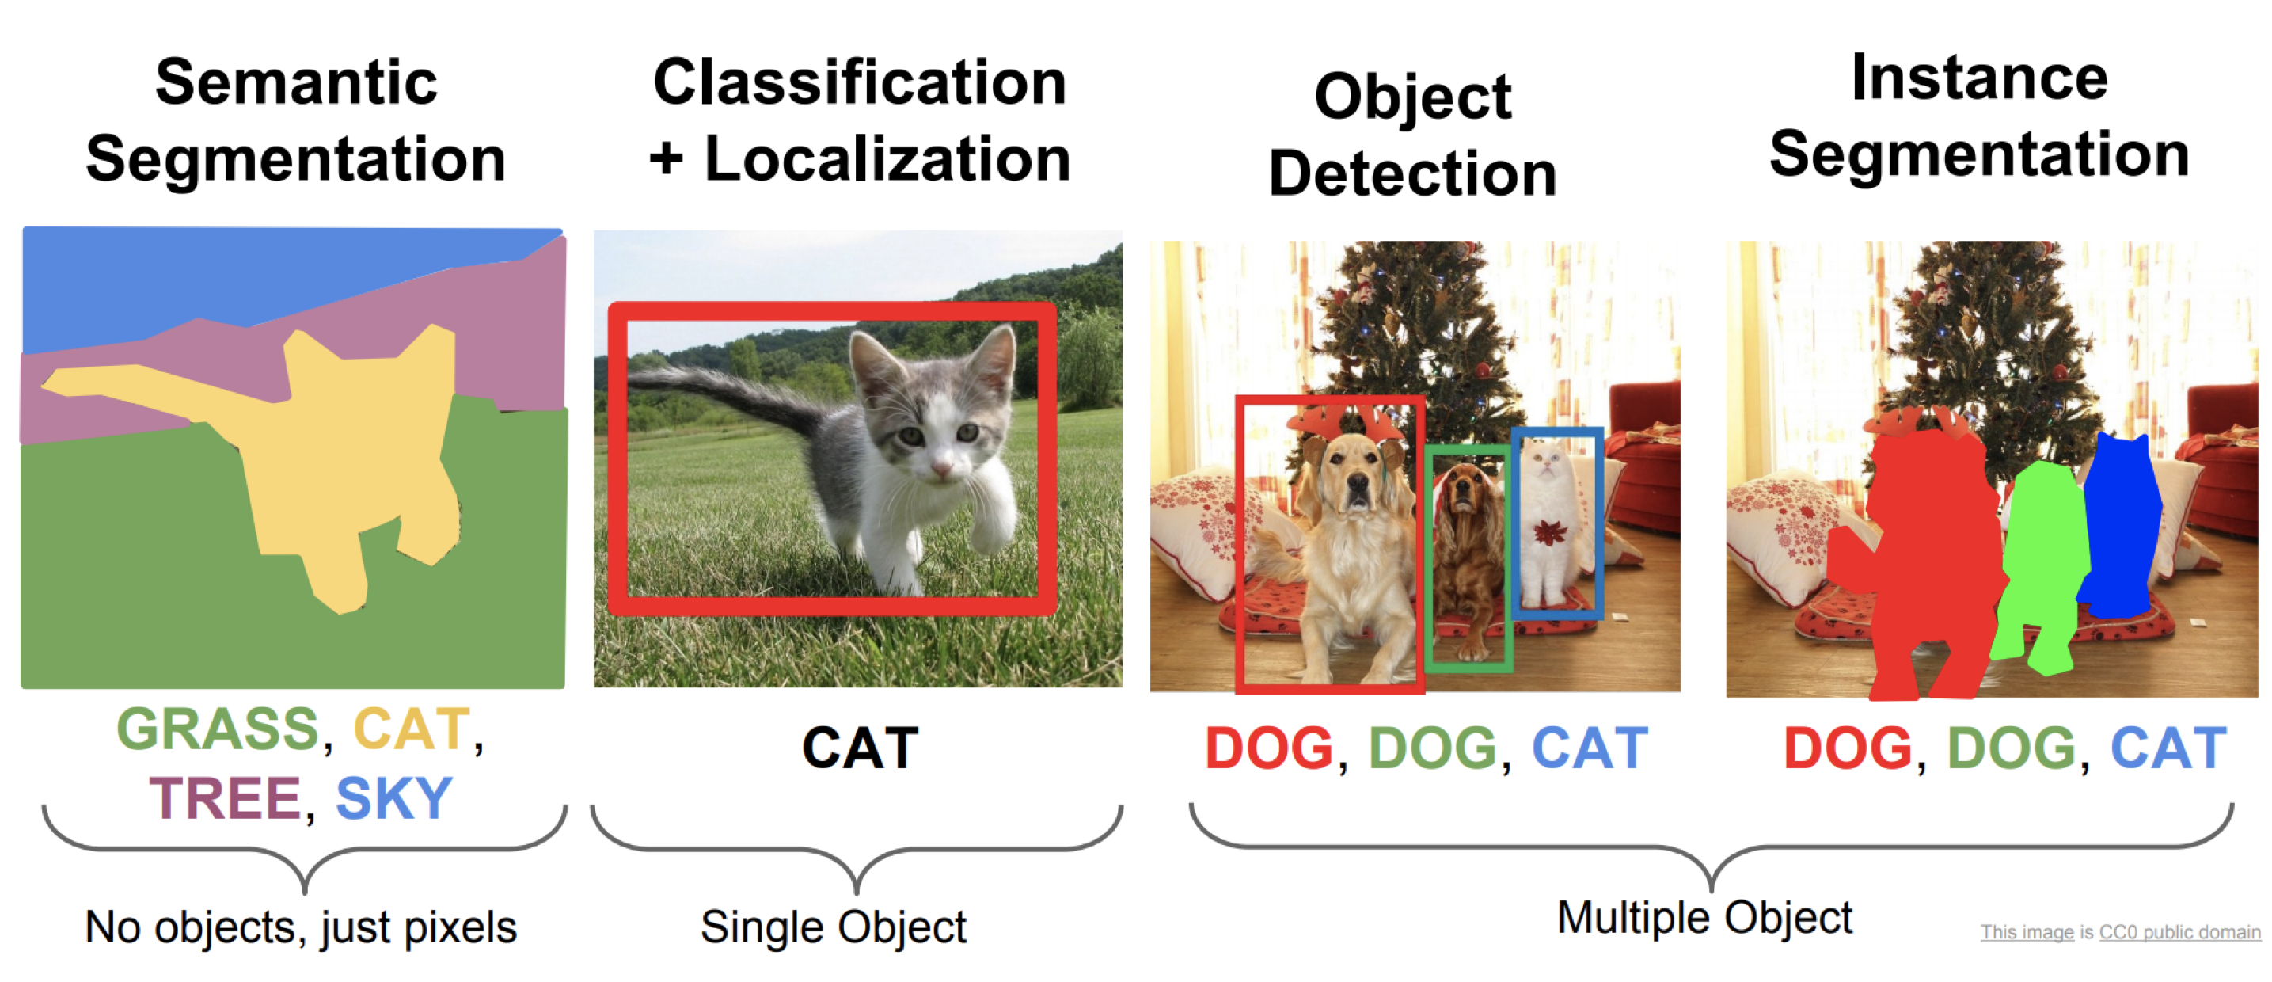
Segmentation and Classification
Alternative segmentation outputs
Different architectures produce different output.
The desired output will drive the selected architecture.

Slide 6

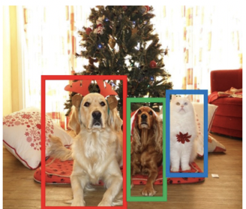
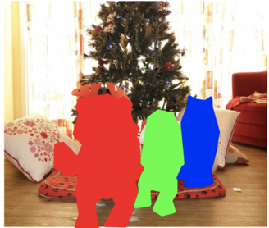
Selection of Architecture
Segmentation Architectures
Semantic
Segmentation
Object
Detection
Instance
Segmentation
Architecture | Description
FCN | Simple datasets with small number of objects | X
Unet | Medical imaging Fine details | X
Mask R-CNN | Includes bounding boxes along with instance segmentation |  | X | X
PSPNet | Good with objects of varying sizes | X
Yolact | Real-time speeds |  | X | X

Slide 7
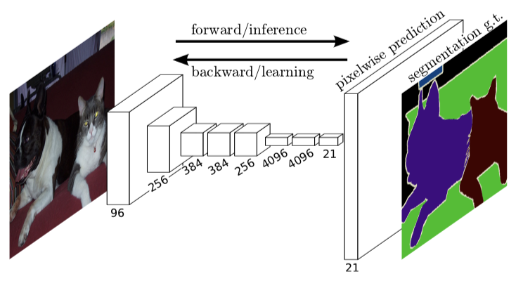
FCN (Fully Convolutional Network)
Early segmentation architecture
Uses CNN’s throughout
https://arxiv.org/pdf/1605.06211v1.pdf

Slide 8
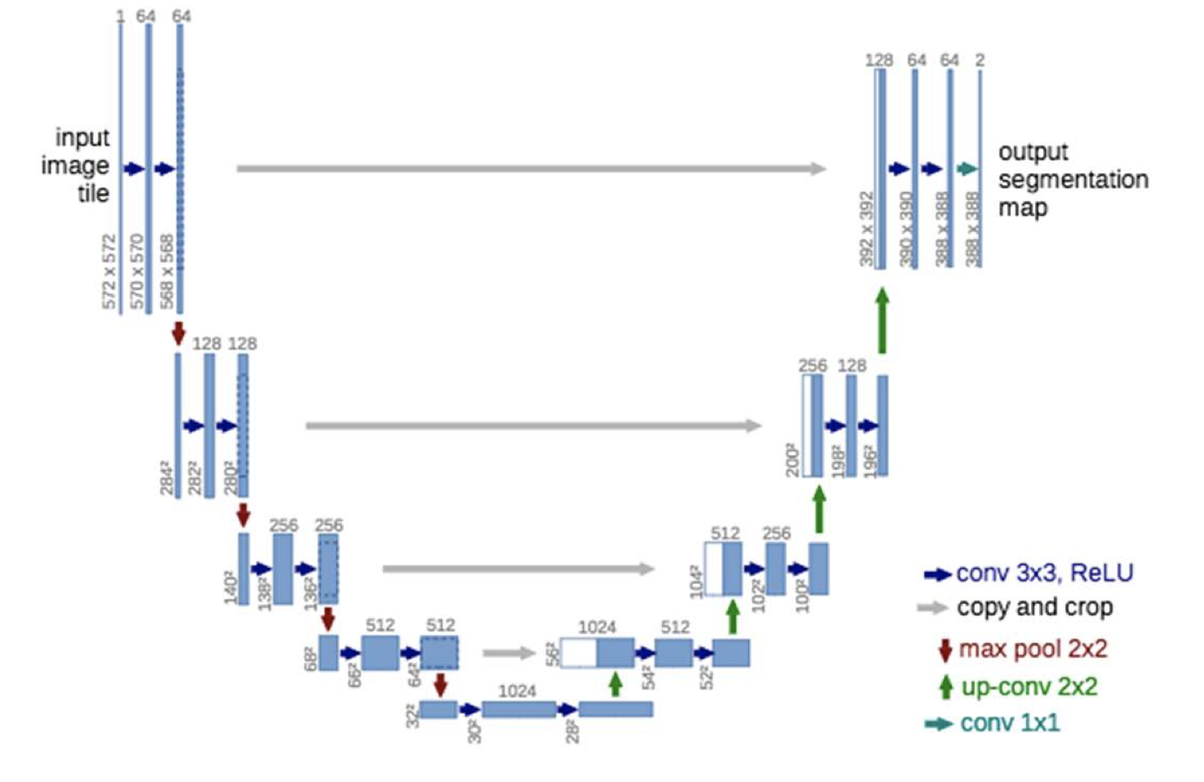
UNet
Uses skip connections to maintain detail in decoder
Used in medical imaging where detail is important
https://arxiv.org/pdf/1505.04597.pdf

Slide 9
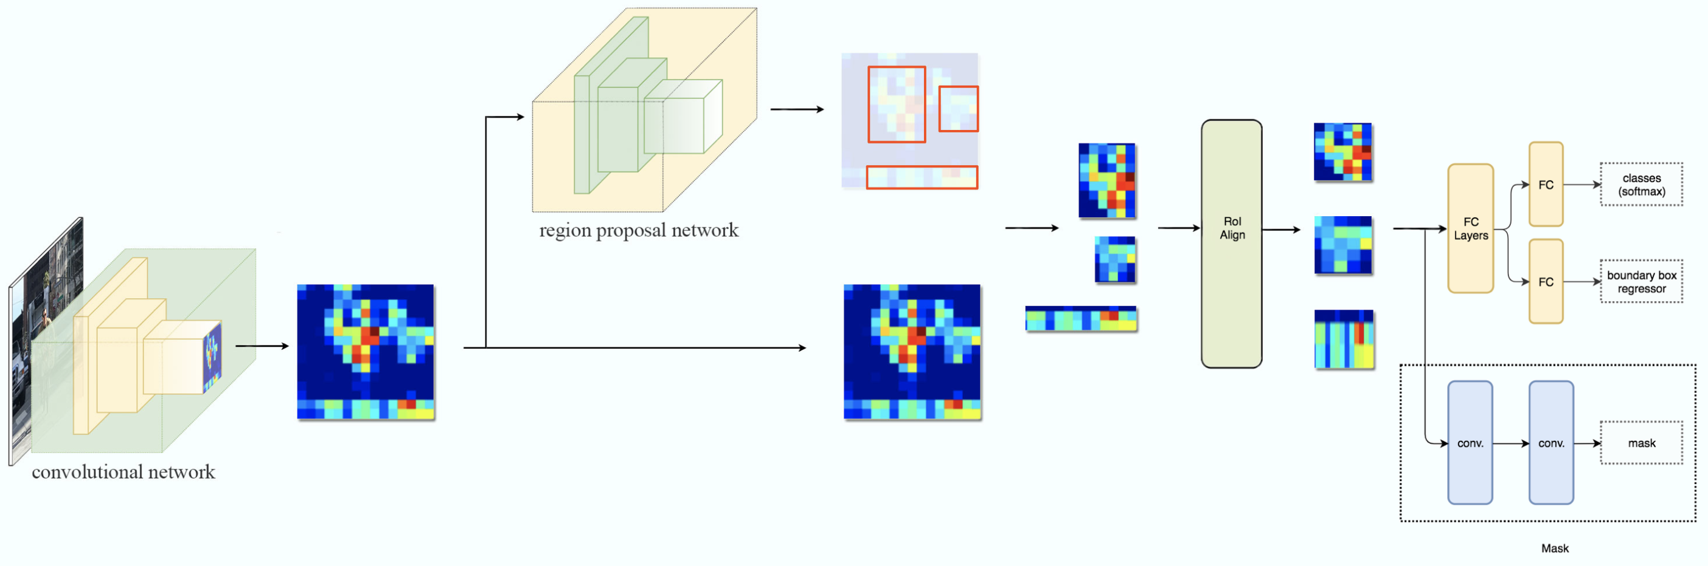
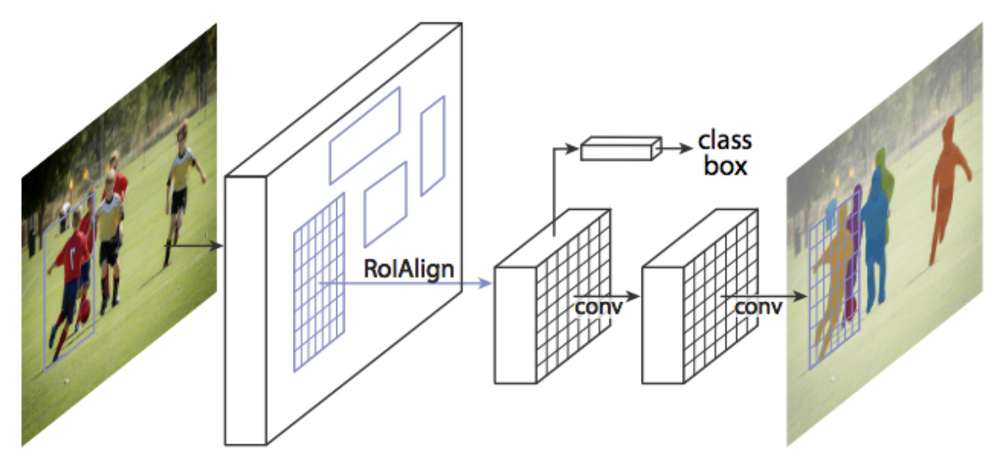
Mask R-CNN
Iteration of R-CNN evolution
Adds segmentation to previous iterations
Includes bounding boxes and instance segmentation
https://medium.com/@jonathan_hui/image-segmentation-with-mask-r-cnn-ebe6d793272
https://arxiv.org/pdf/1703.06870.pdf

Slide 10
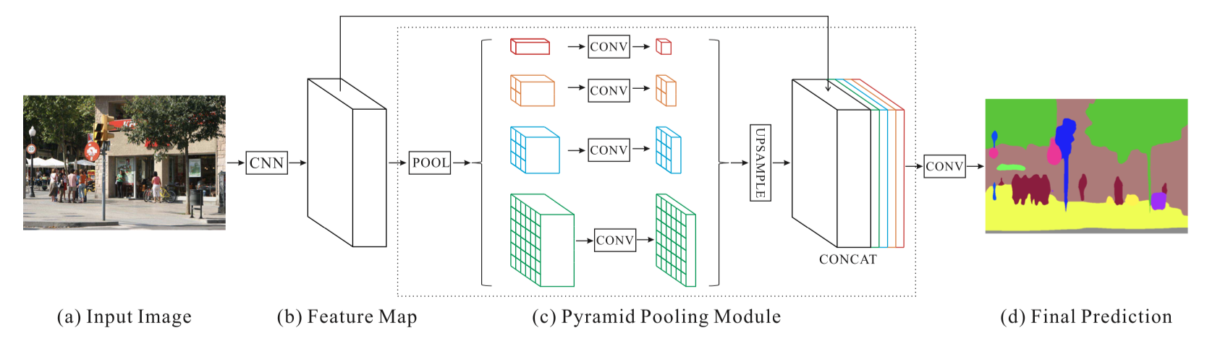
PSPNet (Pyramid Scene Parsing Network)
Detects objects of varying size using Pyramid of convolutions
Classifies based on overall image context
A single PSPNet yields the new record of mIoU accuracy 85.4% on PASCAL VOC 2012 and accuracy 80.2% on Cityscapes.
https://arxiv.org/pdf/1612.01105.pdf

Slide 11
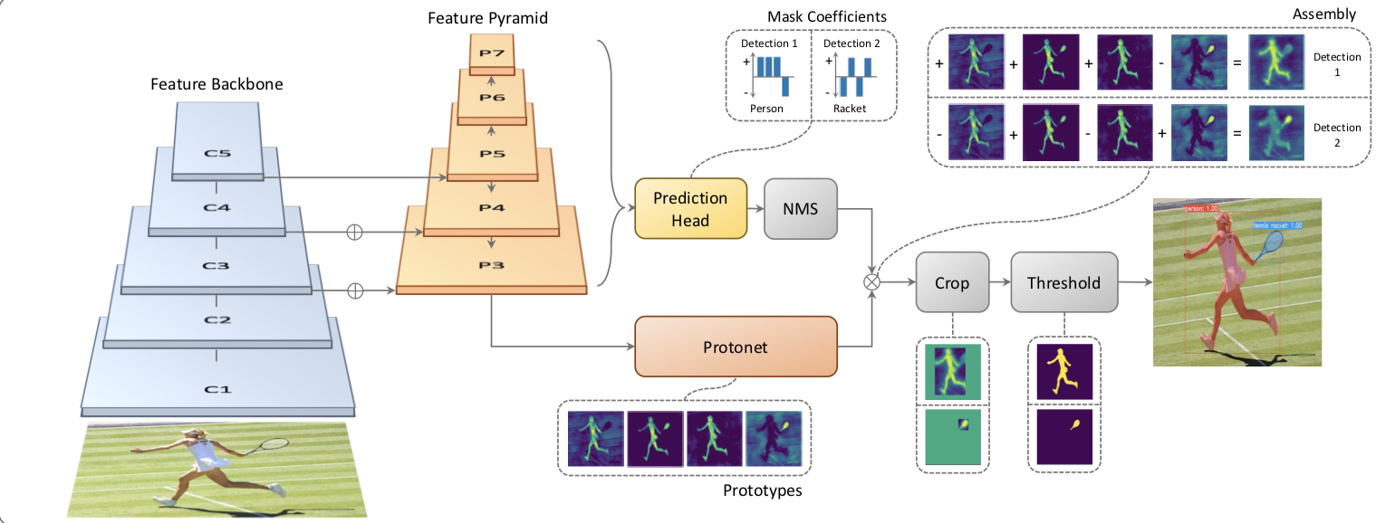
YOLACT (You Only Look At CoefficienTs)
Real-time speeds
Includes instance segmentation and bounding boxes.
http://openaccess.thecvf.com/content_ICCV_2019/papers/Bolya_YOLACT_Real-Time_Instance_Segmentation_ICCV_2019_paper.pdf

Slide 12
Encoder Modularity Example
Build Steps:
Isolate Unet decoder
Import Resnet pretrained network
Connect Layers
Adjust Image scaling for training
Train
Adjust image scaling for inference
ResNet
Unet
Input
Block 1
Block 2
Block 3
Block 4
Block 5
Encoder

Slide 13
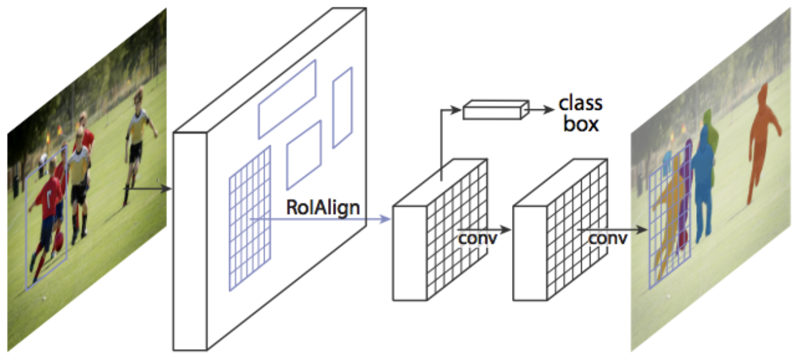
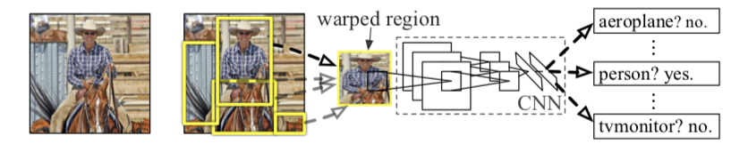
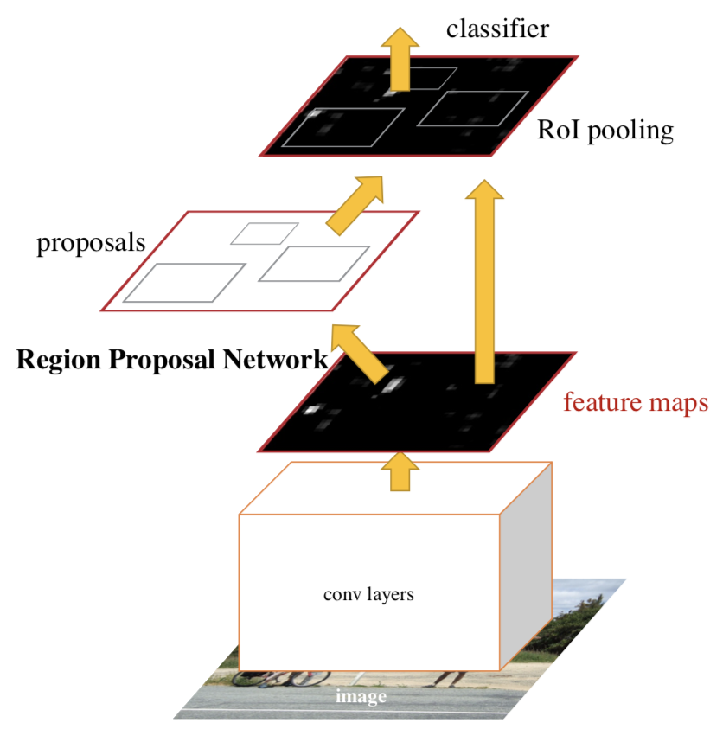
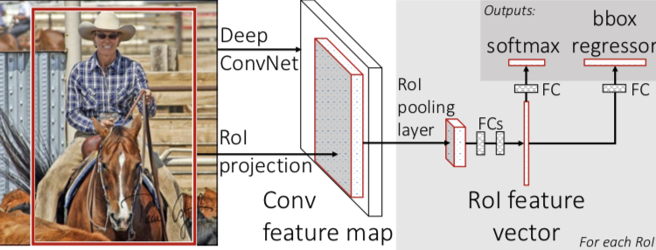
Mask R-CNN - Evolution
Introduced concept of region proposals
Adds Instance Segmentation
3 outputs:
Classification
Bounding Box
Instance Segmentation
(near real-time 5fps)
Single network for features, classification and bounding boxes
Added Region Proposal Network
(near real-time 5fps)
PASCAL VOC (R-CNN)
54%
66%
78%
Oct 2014
R-CNN
Sep 2015
Fast R-CNN
Jan 2016
Faster R-CNN
Jan 2018
Mask R-CNN
https://arxiv.org/pdf/1311.2524.pdf
https://arxiv.org/pdf/1504.08083.pdf
https://arxiv.org/pdf/1506.01497.pdf
https://arxiv.org/pdf/1703.06870.pdf
https://blog.athelas.com/a-brief-history-of-cnns-in-image-segmentation-from-r-cnn-to-mask-r-cnn-34ea83205de4

Slide 14
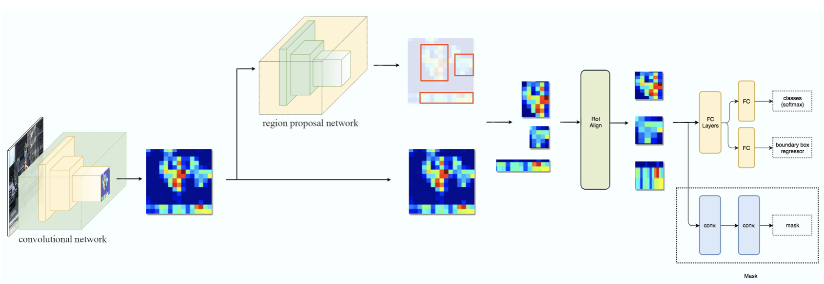
Mask R-CNN – Architecture Overview
Faster R-CNN
Mask R-CNN
Faster R-CNN
- Outputs classification with bounding boxes
Mask R-CNN
Adds segmentation
Introduces Regions of Interest

Slide 15
Mask R-CNN – Backbone/Convolutional Base/Encoder
Faster R-CNN
Mask R-CNN
Backbone:
Reduces image to shapes by removing details
Captures shape information and drops fine-details
Detailed shape information shared during decoding
Enables transfer learning

Slide 16
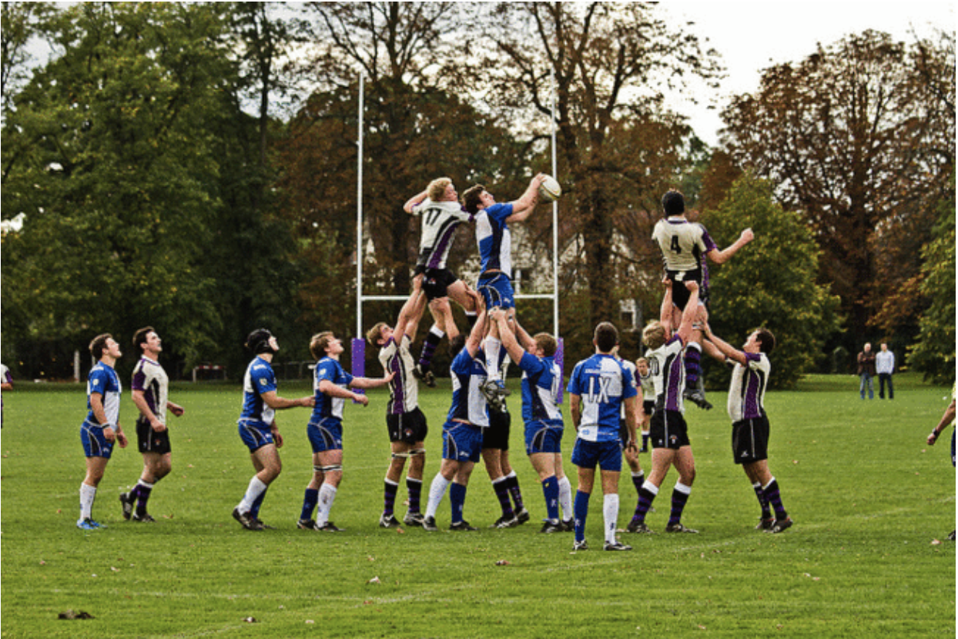
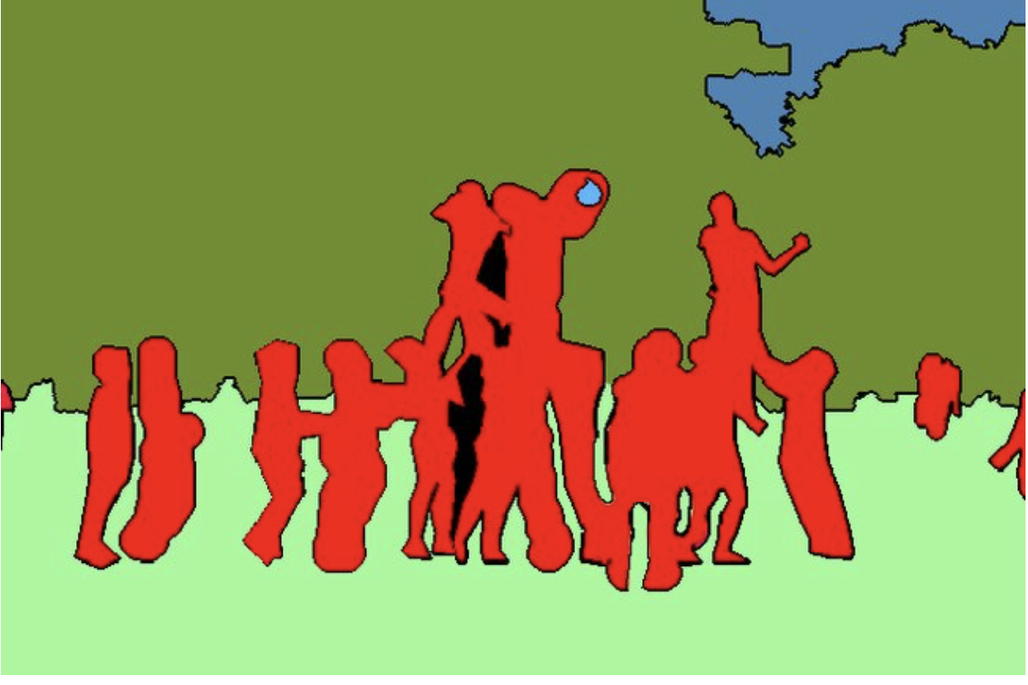
Encoder Architecture
Most segmentation models use an encoder structure
Details shared during decoding
Input:
image
Output: Mask
Encoding
Encoder
Decoder
Modularity:
A benefit of this structure is that the encoder and decoder portions can be separated.

Slide 17
Encoder Architecture
Most segmentation models use an encoder structure
Input:
image
Pre-Trained Network
Output: Mask
Encoding
Encoder
Decoder
Pre-Trained Networks:
ResNet, VGG, …

Slide 18
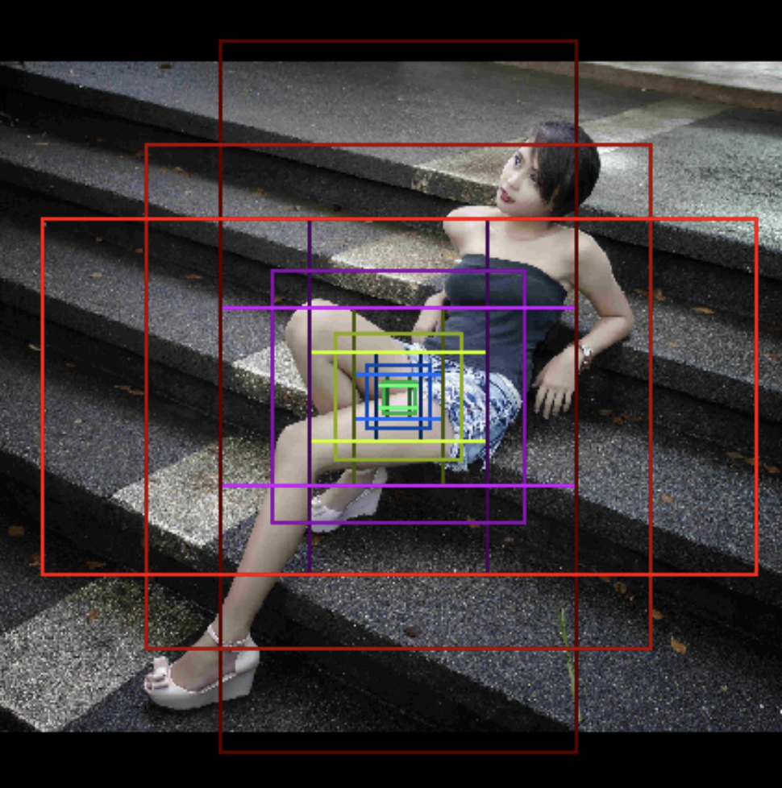
Mask R-CNN – RPN – Region Proposal Network
FashionDataSet
262k regions per image
5 sizes and 3 aspect ratios
Faster R-CNN
Mask R-CNN
Region Proposals:
Faster R-CNN contribution
Defines possible bounding boxes
At regular points in image, various boxes are proposed with different aspect rations and sizes

Slide 19
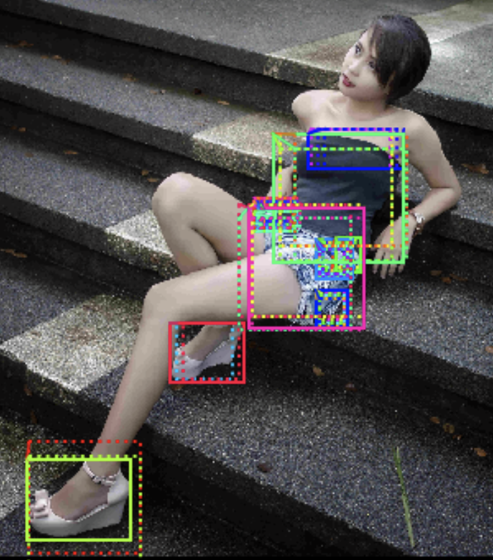
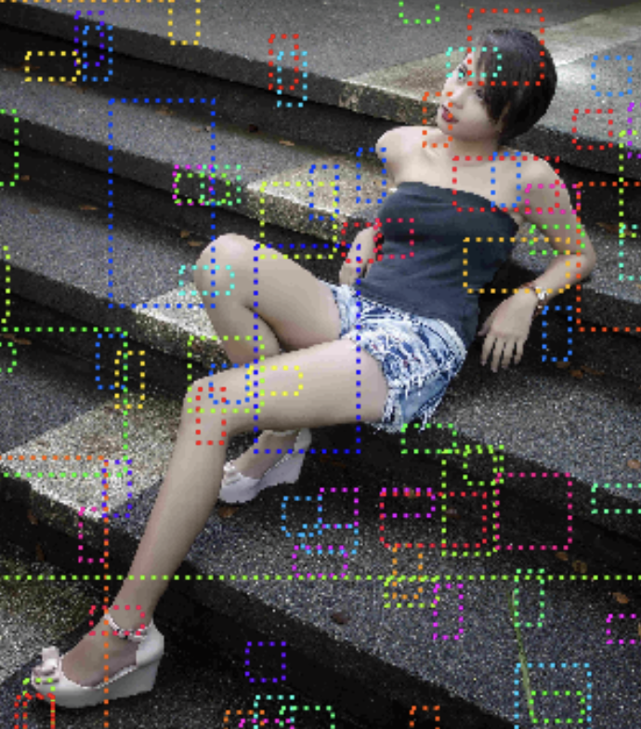
Mask R-CNN – Region Proposals
Positive Scores
Faster R-CNN
Mask R-CNN
Here, we see 52 positive regions.
Negative Scores
Regions evaluated for possible recognized objects
Scores are positive, neutral or negative

Slide 20
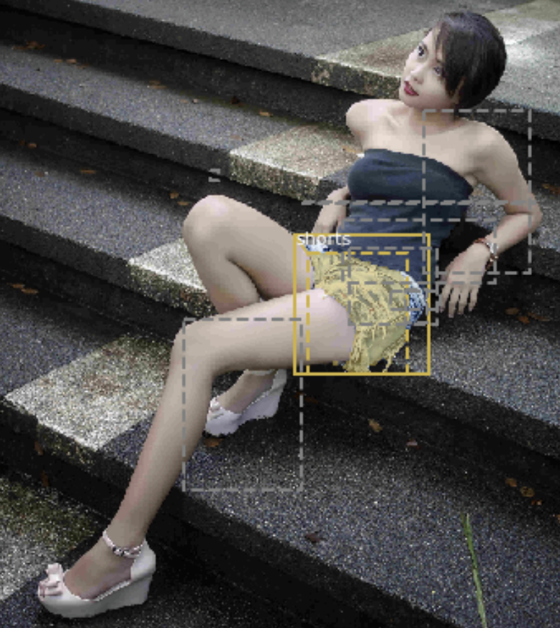
Mask R-CNN – ROI Align – Refined Selections
RPN Results
Faster R-CNN
Mask R-CNN
ROI Alignment
Each selected region is further refined by ROI Align process in Mask R-CNN

Slide 21
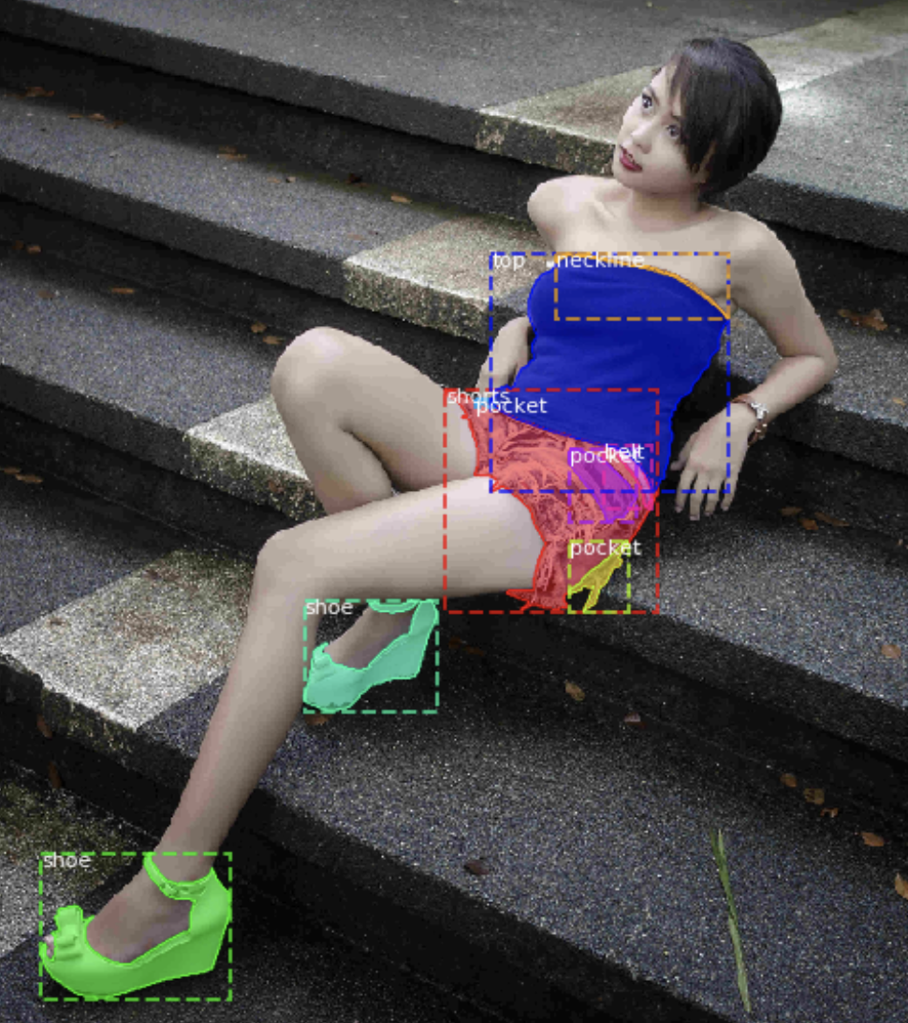
Mask R-CNN – ROI Align – Refined Selections
Faster R-CNN
Mask R-CNN
Mask R-CNN Output
Classification
Bounding Box
Segmentation Mask
Top scoring regions are convolved to create mask
Bounding Box and Classes are output for each selected ROI.
3 network outputs

